Slide 1
DSC530-Term Project
Madison Christiansen

Slide 2
This Fish Market Data Set is a record of seven common fish species in fish market sales. We are looking to see if the weight of the fish is a good indicator of the other variables.
Variables
Weight: Weight of fish in grams
Length1: Vertical length in cm
Length2: Diagonal length in cm
Height: Height in cm
Width: Diagonal width in cm

Slide 3
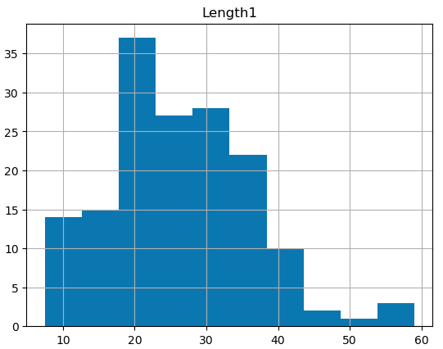
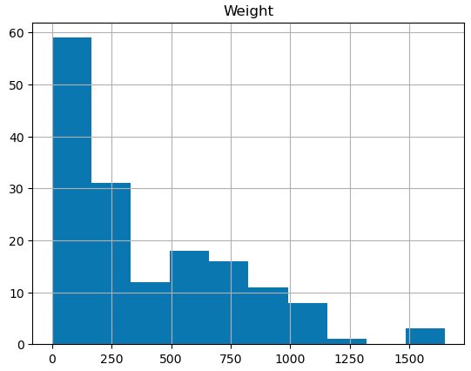
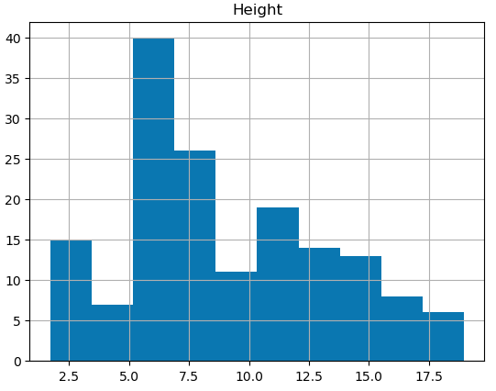
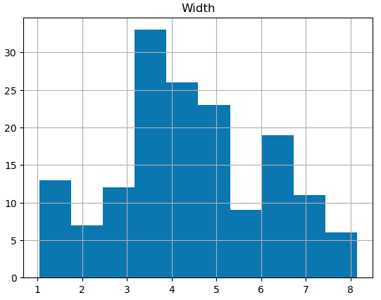
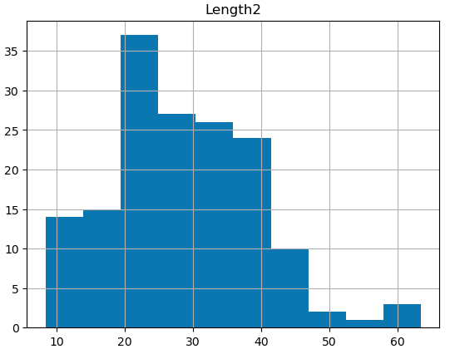
Histogram
Outliers are shown in the Length1, Length2, and Weight histograms. These outliers lie outside of the overall pattern of a distribution and can be due to the case not fitting the model under study. Another reason for the outlier can be due to measurement error. The outliers are a good representation of variations within the population, they should stay included. Since this data set consists of natural species, there will be variations and keeping those stay true to the population.

Slide 4
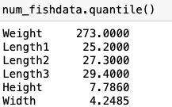
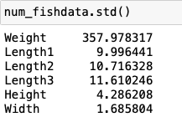
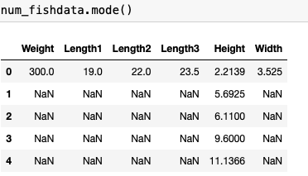
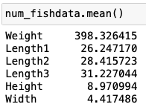
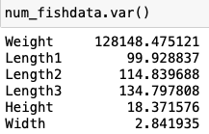
Descriptive Characteristics about Variables

Slide 5
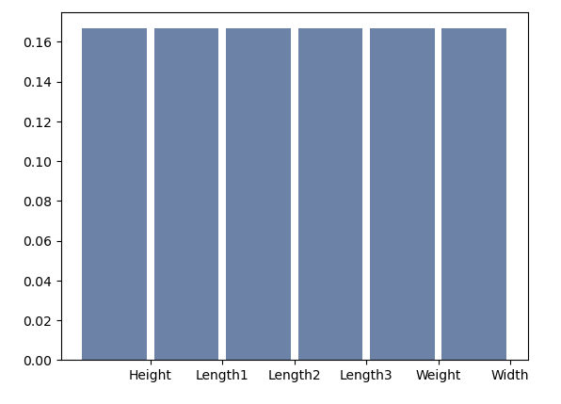
Probability Mass Function
Here the PMF shows as the probability on the y-axis and the variables on the x-axis. This shows us the the variables are equal to the 0.16 probability value.

Slide 6
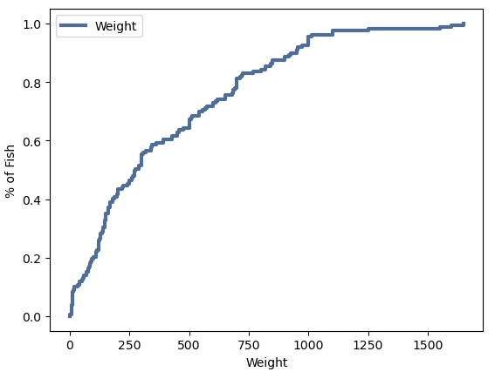
Cumulative Distribution Function
The CDF calculates the cumulative probability for a given x-value. This given x-value we are looking at is the weight of the fish.
Based off this CDF graph you can see that about 95% probability that the fish weight over the 1000 grams mark. We are trying to look at the weight of the fish and how it shows the other variables.

Slide 7
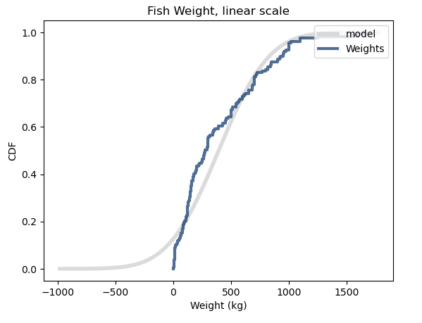
Analytical Distribution
Using the normal distribution see if the data set is approximately normally distributed. This plot shows us that the residuals are mostly normally distributed with just a few outliers. You can see this as the data follow along the same line as the model line.

Slide 8
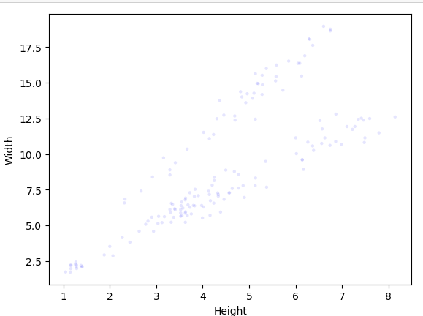
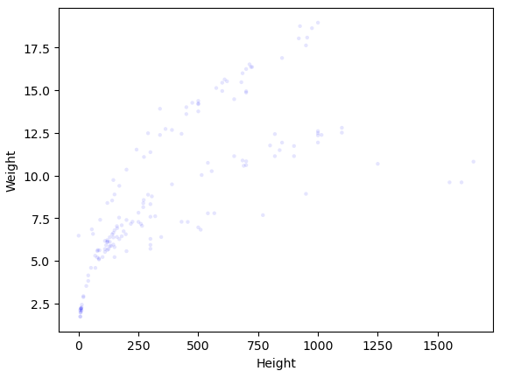
Scatter Plots
When looking at the height vs weight you can see that the more a fish weights this will correlate to the height being greater as well. Then taking this information and comparing the height to the width you can see that the greater widths also correlate to the greater heights. Both plots show a large positive covariance, which indicates positive correlation. The weight vs height graph does show a logarithmic relationship which can indicate that there is a rapid increases in weight although at a certain point a threshold is hit and evens out.

Slide 9
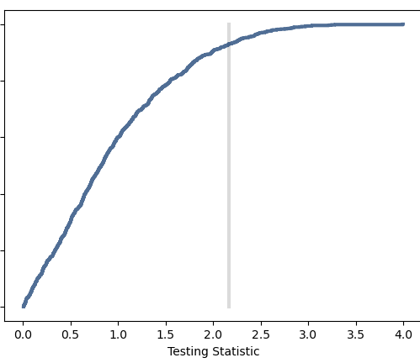
Permutation Test
This test is an exact statistical hypothesis test making use of the proof by contradiction.
We can see that at the threshold line is at 2.2 and the majority had a mean difference above this line. Meaning majority of the data is above this threshold.

Slide 10
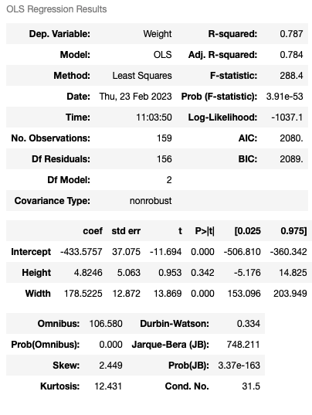
Regression Analysis
For this regression analysis I looked at comparing the weight, height, and width of the market fish. With the weight being the dependent variable.
Looking at the p-value you can see that width is at 0 meaning that the observation is unlikely to be due to chance. The height is 0.3 which is also closer to 0 then 1. This can tell us that the sample size is large enough for deviation from normality to be confirmed.

